Slide 1
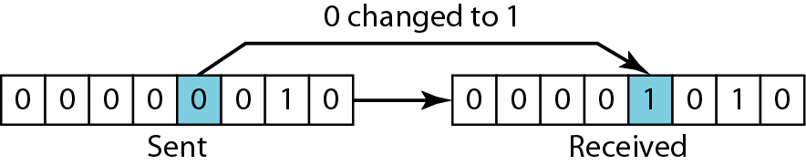
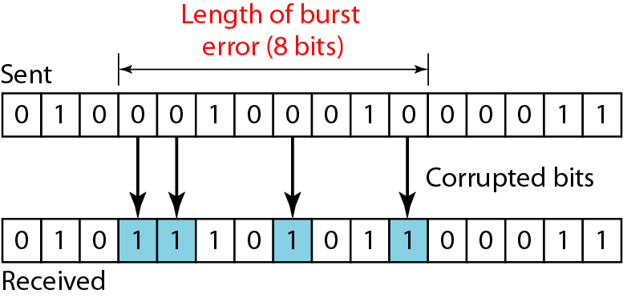
Types of Errors
Single bit error is only 1 bit in the data unit has changed
least likely type of error in serial data transmission
In a burst error, 2 or more bits in the data unit get changed
The length of the burst is measured from the first corrupted bit to the last corrupted bit. OR distance between the first and last errors in data block

Slide 2
Redundancy: Central concept in detecting /correcting errors
Need to send extra (redundant) bits with the data
Extra bits are added by the sender and removed by the receiver
Presence of redundant allows receiver to detect or correct corrupted bits
Coding: Various coding schemes to achieve redundancy
The sender adds redundant bits through a process that creates a relationship between the redundant bits and the actual data bits
The receiver checks the relationships between the two sets of bits to detect or correct the errors
In any coding scheme, the ratio of redundant bits to the data bits and the robustness of the process are important factors

Slide 3
Detection Versus Correction
Error detection concerns only to see if any error has occurred
Simply Yes or No
Even not interested in the number of errors (corrupted bits)
Single bit error is same as the burst error
Error correction: need to know the exact number of corrupted bits and their location in the message (more important)
The number of the errors and the size of the message are important factors
In an 8 bit data
To correct a single bit error, need to consider eight possible error locations
To correct two errors, need to consider 28 possibilities or combinations
Imagine the receiver's difficulty in finding 10 errors in a data unit of 1000 bits

Slide 4
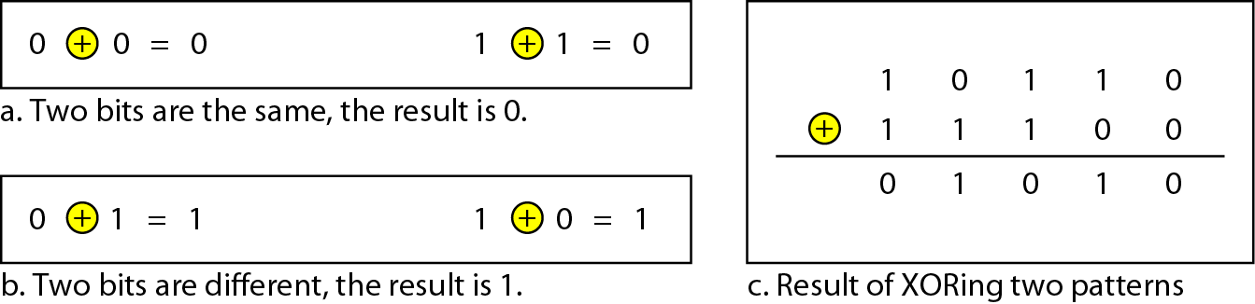
Modular Arithmetic
uses only a limited range of integers
modulo-N arithmetic
define an upper limit, called a modulus N
then use only the integers 0 to N - I, inclusive
no carry when adding two digits in a column
no borrow when subtracting one digit from another in a column
In Modulo-2 arithmetic (XORing of two single bits or words

Slide 5
Error Control Requirements
The most common techniques for error control are based on some or all of the following ingredients:
Error detection
Receiver detects errors and discards PDUs in error
Positive acknowledgement
Destination returns acknowledgment of successfully received, error-free PDUs
Retransmission after timeout
Source retransmits unacknowledged PDUs after a predetermined amount of time
Negative acknowledgement and retransmission
Destination returns negative acknowledgment to PDUs in which an error is detected
The source retransmits such PDUs

Slide 6
Error Detection Codes
Data are transmitted as one or more contiguous sequences of bits, called frames
Data transmission can contain errors (single bit or burst)
Error detection codes detects the presence of an error
How to detect errors?
If only data is transmitted, errors cannot be detected
Send more information with data that satisfies a special relationship 🡪 Add redundancy
Error-detecting codes are commonly used in link, network, and transport layers

Slide 7
Error Detection Process
Transmitter
For a given frame of bits , the transmitter adds additional bits that constitute an error-detecting code
an error-detecting code (check bits) is calculated from transmitted (data) bits
Check bits are appended to data bits
Receiver
Separates incoming frame into data bits and check bits
Calculates check bits from received data bits
Compares calculated check bits against received check bits
A detected error occurs if and only if there is a mismatch

Slide 8
Error Detection Codes Parity Check
Parity bit (a single bit) appended at the end of data block
Even parity
Added bit ensures an even number of 1s
Odd parity
Added bit ensures an odd number of 1s
Example, 7-bit character [1110001]
Even parity [11100010]
Odd parity [11100011]

Slide 9
Parity Check
If the transmitter is transmitting 1110001 and using odd parity
It will append a 1 and transmit 11100011
The receiver examines the received character and if the total number of 1s is odd
No error
If 1 bit or any odd number of bits is inverted during transmission, For example,
Then the receiver will detect an error
Performance:
Detects all odd-number errors in a data block (1,3,5,…bits in error)
Detects NO errors that flip an even number of bits (2, 4, 6, … bits in error)

Slide 10
Error Detection Codes: Cyclic Redundancy Check (CRC)
One of the most common and powerful error-detecting codes
Transmitter
For a given k-bit block, transmitter generates an (n-k)-bit frame check sequence (FCS)
Resulting frame consisting of n bits is exactly divisible by predetermined number (a pattern)
Receiver
Divides incoming frame by predetermined number
If no remainder, assumes no error
Procedure can be represented by
Modulo 2 Arithmetic
Polynomials

Slide 11
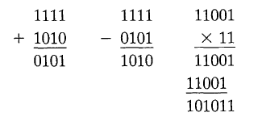
Modulo 2 Arithmetic
Modulo 2 arithmetic is performed digit by digit on binary numbers
Each digit is considered independently from its neighbors
Binary addition with no carries: Exclusive-OR (XOR)
Binary subtraction with no borrows: as the XOR operation
CRC using Modulo 2 Arithmetic
Parameters:
T = n-bit frame to be transmitted
D = k-bit block of data; the first k bits of T
F = (n – k)-bit FCS; the last (n – k) bits of T
P = pattern of n–k+1 bits; this is the predetermined divisor
Q = Quotient
R = Remainder

Slide 12
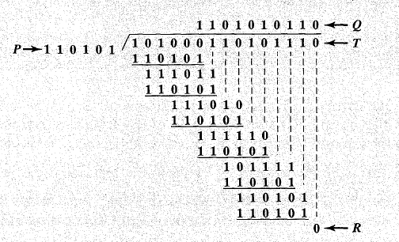
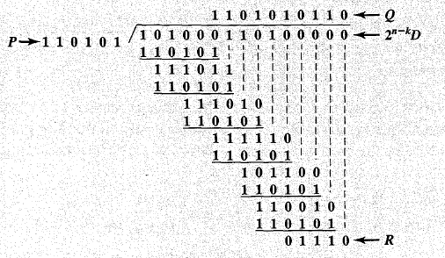
CRC using Modulo 2 Arithmetic: Example
Given: Pattern (diviser)P = 110101 (6 bits) --------- n-k+1
FCS = to be calculated (n-k = 5 bits)
Message D (k-bit block) = 1010001101 (10 bits)
Thus, n (total bits) = 15 (as n-k+1 = 6), k = 10 and n-k = 5 bits
The message is multiplied by 2⁵, producing 101000110100000
The product is divided by P
The remainder is added to 2⁵D to give T = 101000110101110
If no errors, then receiver receives T as it is. The received frame is divided by P
If there is no remainder, it is assumed that there have been no errors

Slide 13
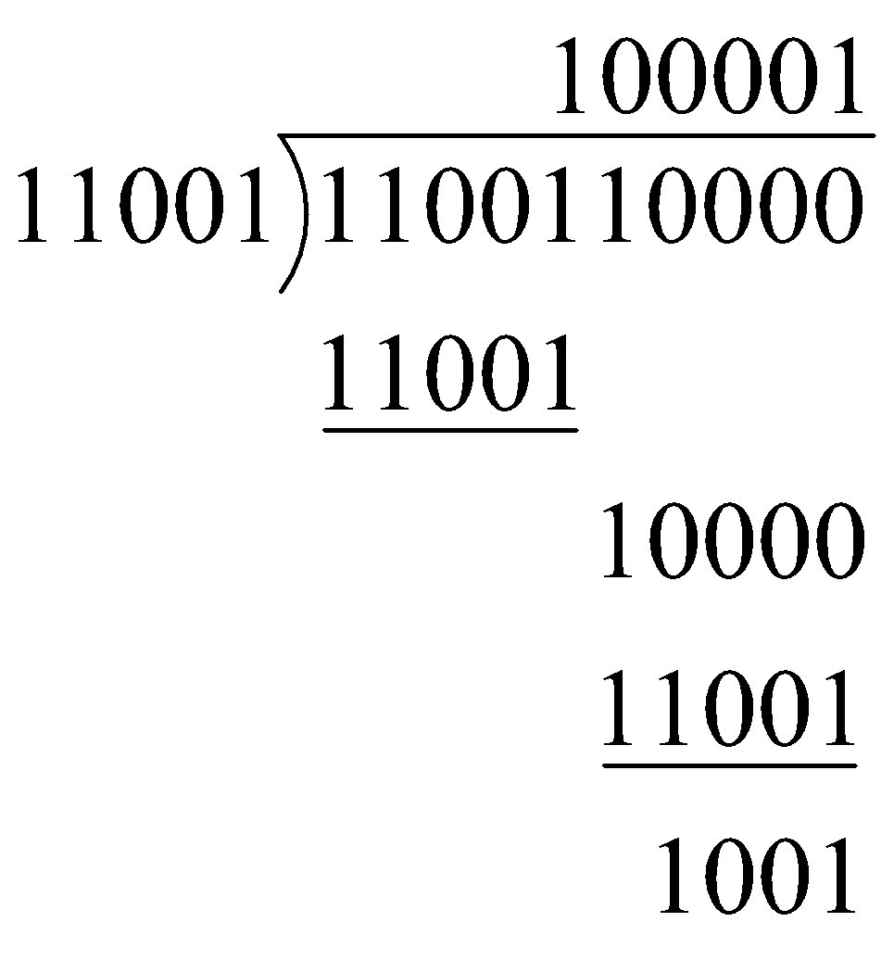
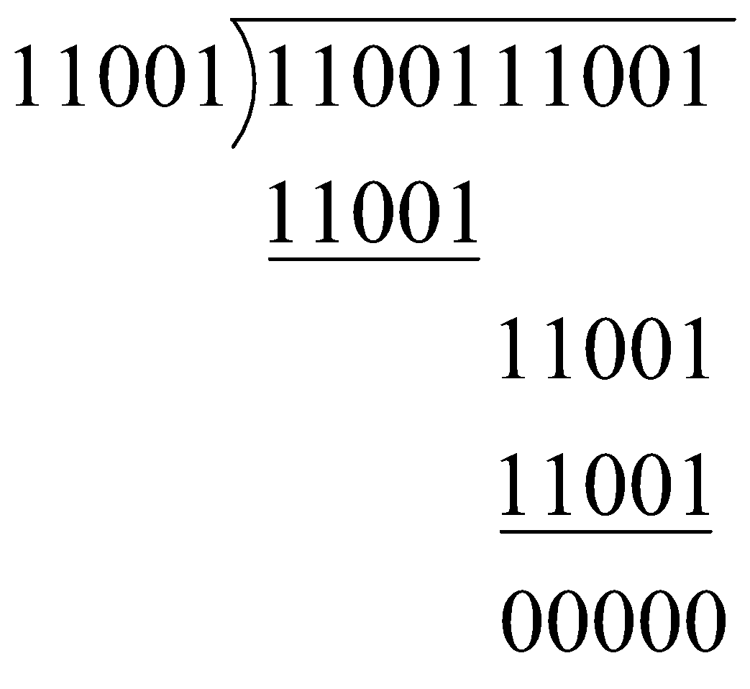
CRC using Modulo 2 Arithmetic: Example
Given: Pattern (diviser)P = 11001 (5 bits) --------- n-k+1
FCS = to be calculated (n-k = 4 bits)
Message D (k-bit block) = 110011 (6 bits)
Thus, n (total bits) = 10 (as n-k+1 = 5), k = 6 and n-k = 4 bits
Transmitted block T = 1100111001
At Receiver
= R(x)
No remainder
🡪 Accept
Send the block 110011 1001

Slide 14
CRC using Polynomials
All values expressed as polynomials
Dummy variable X with binary coefficients
The coefficients correspond to the bits in the binary number
For D = 1010001101 -----D(X) = X⁹+ X⁷ + X³ + X² + 1
For P = 110101 -----P(X) = X⁵+ X⁴ + X² + 1

Slide 15
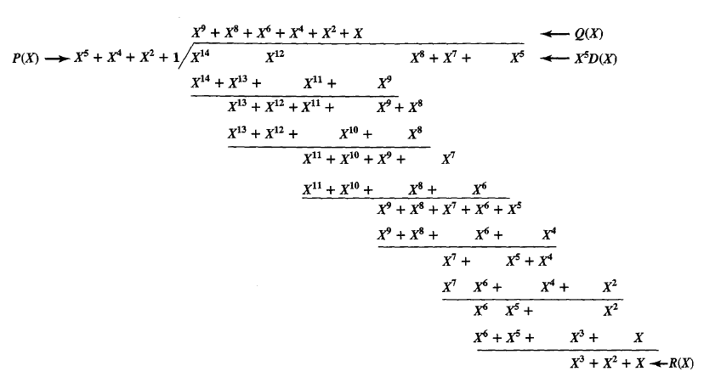
CRC using Polynomials: Example
Taking previous example
For D = 1010001101 -----D(X) = X⁹+ X⁷ + X³ + X² + 1
For P = 110101 -----P(X) = X⁵+ X⁴ + X² + 1
End up with R = 01110-----R(X) = X³+ X² + X

